Slide 1


Towards Effective Virtualization of Intrusion Detection Systems
Nuyun Zhang†, Hongda Li†, Hongxin Hu†, and Younghee Park‡
†
‡
SDN-NFV Security 2017

Slide 2
Outline
Introduction
Motivations
Our Approach
Feasibility of our approach
IDS virtualization as microservice
Experiments
Benefits of scaling individually
Benefits of customization
Notes:
I will first give the introduction and the motivations of our work.
Then I will discuss the feasibility of our approach, followed by more details of our approach.
Finally, I will discuss our experiments

Slide 3
Traditional IDSes
Single process IDS
Cannot scale to large volume of traffic
Parallelization of IDS
Clustered IDS: costly, fixed location/capacity
Multi-core/thread IDS: fixed capacity
Traditional IDSes are inflexible
Notes:
Intrusion detection system is a critical network security function that monitors a network or system to detect malicious activities or security policy violation.
Originally, IDS is implemented as single process and is hard to scale to large traffic volume.
Then clustered IDS is proposed to have better scalability to large traffic volumes.
To fully utilize the current multi-core CPU technologies, then IDS is designed to run on multiple threads.
However, these IDS solutions are inflexible, because number of the machines in a cluster and the number of cores in a machine is fixed.
So traditional IDS are not flexible to monitor our networks and systems.

Slide 4
Virtualized IDS Based on NFV+SDN
New features
Dynamically create/destroy instances
Dynamically redistribute traffic
Current state
Split/Merge [NSDI’13]
OpenNF [SIGCOMM’15]
Treat virtualized IDS as monolithic piece of software
Notes:
Recently, there are two emerging network technologies. NFV and SDN.
IDS can be virtualized to run on virtual machines that can be dynamically created, destroyed or migrated, which provides more elasticity.
Some existing works, like split/merge and OpenNF, have studied dynamic state management for virtualized network functions.
Unfortunately, all these existing works treat a virtualized IDS as a monolithic piece of software, where components within one virtualized IDS cannot run independently.
The nature of monoliths make the distribution of virtualized IDS into cloud-based systems with significant limitations.

Slide 5
Limitations of Monolithic Virtualized IDS (1/3)
Inefficient Resource Usage
Available Resource Unusable
Can’t fit
Monolithic
Instance
Cloud
Notes:
The first limitation is inefficient resource usage.
When we want to provision a virtualized IDS instance. The monolithic instance needs a big slice of resource.
So it’s impossible for monolithic instance to use those small slices of resource in the could. In addition, finding a big slice of resource in the cloud is more difficult to find a small one.

Slide 6
Limitations of Monolithic Virtualized IDS (2/3)
Hard Customization
Customization for
different purposes
Monolithic
Virtualized IDS
Knowledge of source code
Error-prone
Implementation-dependent
Customized IDSes
Notes:
0> The next limitation is that is hard for customization.
1> People may want to tailor the IDS for different purpose. For example, in some situation, the user wants to remove some less useful components to reduce the resource consumption.
But this is hard to achieve for monolithic virtualized IDS.
2> Because it requires mastery of knowledge of the source code of IDS.
In addition, the manual customization of a complex IDS is error-prone.
What’s more, the customization is implementation-dependent and is hard to apply to many IDSes.

Slide 7
Limitations of Monolithic Virtualized IDS (3/3)
Inflexible Scalability
Underloaded
Overloaded
Detector₁
Detector₂
Parser
Detector₁
Detector₂
Monolithic
Virtualized IDS
Scale-out
Underloaded
Parser
Monolithic
Virtualized IDS
Detector₁
Detector₂
Parser
Monolithic
Virtualized IDS
Notes:
The third limitation is inflexible scalability.
Virtualized IDS based on NFV and SDN can dynamically scale.
However, the scaling of monolithic virtualized IDS is inflexible.
For example, a monolithic virtualized IDS has multiple components. One of the components is overloaded and begins to report packet loss.
The NFV technology can quickly scale out by adding more virtualized IDS instances and redistributing the traffic evenly.
However, most of the other components are not overloaded.
After scaling out, those components are underloaded.
This wastes a lot of the could resource.

Slide 8
Our Approach
IDS Virtualiaztion as Microservice
What is microservice?
Breaking application into independent smaller components
Components communicate through lightweight mechanisms
Why microservice?
Small and lightweight
Scale individually
Run independently
Notes:
0> How can we solve those limitations?
1> We propose IDS virtualization as microservice.
2> So what is microservice? Micorservice is now widely used in cloud environment.
It breaks the application into small independent components. And components can communicate by lightweight mechanisms, such as rest API.
3> Microservice has many good features.
Each of the service is small and lightweight.
They can scale individually.
And each microservice can run independently.

Slide 9
Feasibility of Our Approach
Alerts, logs
IDS
Run independently
Communicate via well-defined messages
High-level analysis
Per-connection,
simple events
Run independently
Communicate via well-defined messages
Traffic
Low-level
per-connection parsing
Low-level per-connection parsing
Check-sum verification, stream reconstruction, pattern matching, etc.
High-level analysis
Cross-event detection tasks.
Notes:
0> We studied the IDS and identify two major components.
1> One component is the low-level parsing, The outputs of this component, are per-connection events. Such as, a file download from a suspicious IP.
2> Another component is the high-level analysis components, which can conduct cross-event detection analysis, and output the alerts, notifications or logs.
3> These two components can run independently, and they can communicate through well-defined messages.

Slide 10
IDS Virtualization as Microservices
Decomposing of virtualized IDS
Low-level connection parsing service
High-level attack detecting service
Scheduler
Detecting service₁
Parsing service₁
Scheduler
Detecting service₂
Traffic
Parsing service₂
Detecting service₃
Notes:
0> So we propose to decompose virtualized IDS into two microservices.
1> one is the low-level connection parsing service, that receive the traffic from the network and generate per-connection events.
2> Another one is high-level attack detecting service, that receives the per-connection events and conduct cross-event detecting.
3> A scheduler is required to schedule the services.
Each service can be instantiated independently and scale individually.

Slide 11
Efficient Resource Usage
Available Resource Unusable
Microservice
Instances
Cloud
Notes:
0>
1> With IDS as microsercie, Each micorservice instance is much smaller than a monolithic instance.
2> So it’s more easier to find a piece of resource in the could to provision.
And small fractions of resources can be used by the lightweight microservice instances.

Slide 12
Easy Customization
Microservices
Customization for different purposes
Monolith
Knowledge of source code
Error-prone
Implementation-dependent
Customized IDSes
User-level service composing
Automation customizing
Implementation-independent
Notes:
0> For customization.
1> Originally, it’s difficult to make customization for monolithic virtualized IDS, because of the limitations I mentioned before.
2> We can address these limitations by virtualizing IDS as microservices.
we can easily compose different services in a service chain to achieve different purpose customization.
And this customization is possible to be achieved in an automatic way.
In addition, because the IDS is virtualized as multiple microservices. As long as the microservices provide standard interface, the customization is implementation-independent.

Slide 13
Flexible Scalability
Detecting service₁
Parsing service₁
Detecting service₂
Scheduler
Traffic
Detecting service₃
Parsing service₂
Overloaded
Detecting service₄
Individually scaling
Agility and Efficiency
Notes:
0> IDS virtualization as microservices also enables flexible scalability.
1> If one of the micorservice instance is overloaded.
2> We can only start a new instance for that micorsservice and leaving the instances other microservices unchanged.
3> That means, the microvervices can scale individually.
4> Since each time we start a new microservice instance, which much smaller than a monolithic instance, we can achieve better agility.
Also, scaling out one microservice will not affect other micorservice, which also means the resource usage is more efficient.

Slide 14

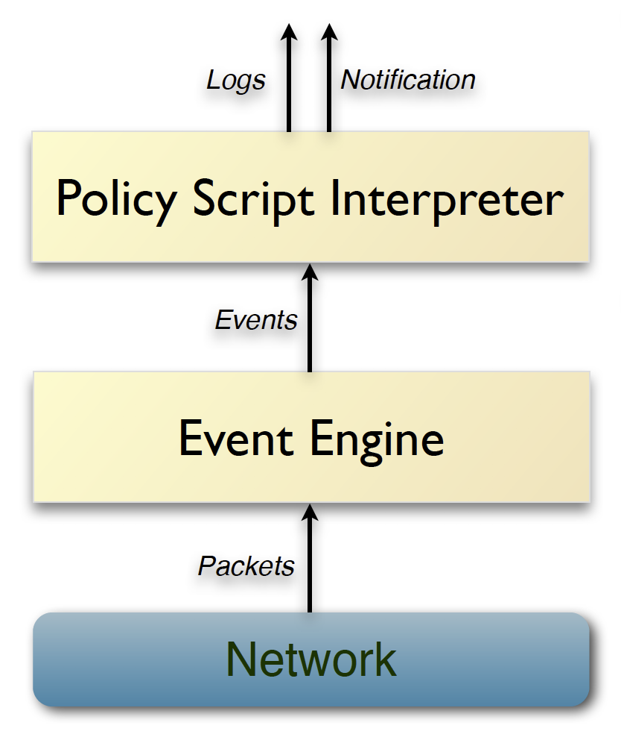
Experiments
Evaluate the benefits of:
Scaling individually
Customization
Simulation
No policy scripts → Low-level parsing service
Selective policy scripts → High-level detecting service
Real network traffic dataset
Mid-Atlantic Collegiate Cyber
Defense Competition
Notes:
0> We also conducted experiments to evaluate the benefits of scaling individually and customization.
1> We use Bro to simulate the microservices. Because Bro has an event engine that works similarly as our low-level parsing service.
The policy scripts interpreter works similarly as our high-level detecting service.
2>

Slide 15
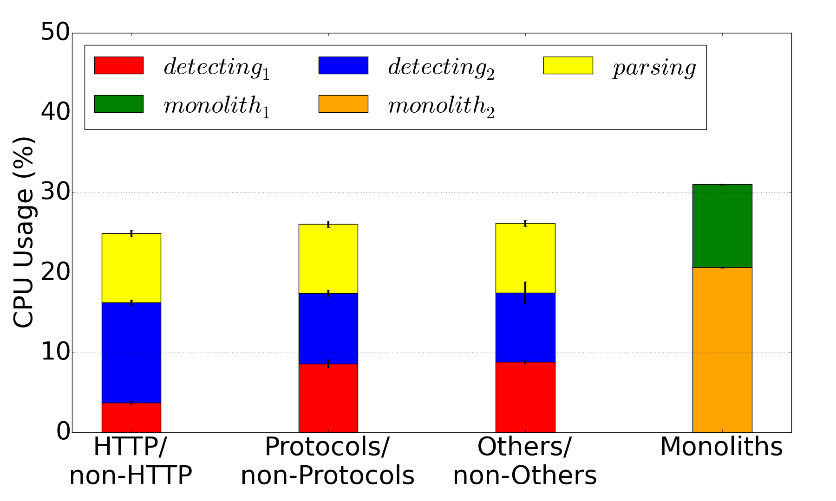
Benefits of Scaling Individually
Microservices
CPU Usage for Microservices and Monoliths

Slide 16
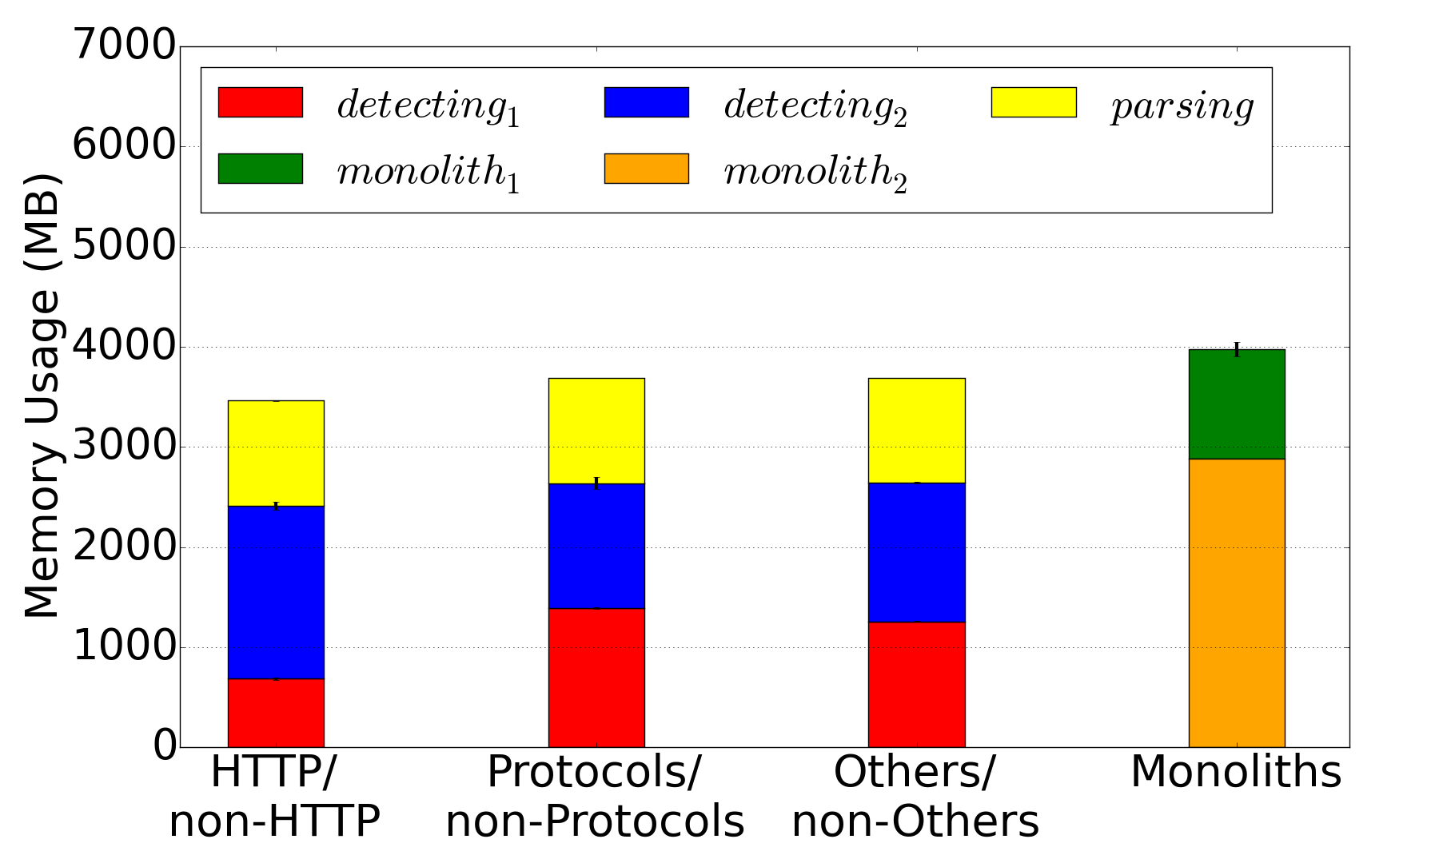
Benefits of Scaling Individually
Microservices
Memory Usage for Microservices and Monoliths

Slide 17
Benefits of Customization
Bro policy scripts customization
Type of traffic | Load All | Customized scripts
HTTPS | Load all policy scripts | Load only HTTPS scripts
HTTP | Load all policy scripts | Load only HTTP scripts
SSH | Load all policy scripts | Load only SSH scripts
Others | Load all policy scripts | Load any other scripts
Scenario 1: without customization
Scenario 2: policy scripts customization
Notes:
We start from Bro policy customization.
According to the mix of our traffic dataset, we classify the traffic based on protocols into four portions such that every type of traffic has similar volume.

Slide 18
Benefits of Customization
CPU Usage
Type of traffic | All scripts | Customized | Benefits
HTTPS | 30.2% | 28.1% | 7.1%
HTTP | 29.4% | 26.6% | 9.2%
SSH | 15.8% | 15.0% | 4.7%
Others | 34.2% | 33.2% | 2.8%
Less CPU usage
Memory Usage (MB)
Type of traffic | All scripts | Customized | Benefits
HTTPS | 1153.5 | 1027.5 | 10.9%
HTTP | 721.0 | 636.0 | 11.8%
SSH | 735.0 | 654.0 | 11.0%
Others | 1252.0 | 1087.5 | 13.1%
Less Memory usage

Slide 19
Discussion and Future Work
Building Virtual IDS
Security challenge: multi-step attacks
Network Security as a Service
FW-as-a-Service
IDS-as-a-Service
New security NF-as-a-Service?
IoT Security
Highly customizable
Agility
Notes:
diverse devices environment & device behaviors change rapidly

Slide 20
Q & A
Thank you!

Slide 21
Back up
Limitation of our experiments
Microservices
Traffic volume variation

Slide 22
Limitations of Our Experiments
Bro uses disproportional CPU in lower traffic environment.
Benchmarking – Pseudo realtime.bro
In the future, send events to bro detector– capture_events
Metrics: includes memory and communication time
Real data from Internet/enterprise network

Slide 23
Microservices vs. Monoliths
Mircoservices: monitor all traffic
Resource: R₁
Resource: R₂
Resource: R₃
R₃: parsing service
R₁-R₃: detecting service for HTTP
R₂-R₃: detecting service for non-HTTP
All except HTTP scripts
HTTP scripts
No scripts
Event Engine
Event Engine
Event Engine
All traffic
Monoliths: monitor all traffic
Resource: R₅
Resource: R₆
Resource Usage
All except HTTP scripts
Microservices | Monoliths
R₃ + (R₁-R₃)+(R₂-R₃) | R₅+R₆
HTTP scripts
Event Engine
Event Engine
HTTP traffic
Non-HTTP traffic

Slide 24
Microservices
Increasing concurrency and DevOps requirements
Small services running in their own processes independently while communicating with each other through lightweight mechanisms
Breaking an application into smaller and completely independent components, enabling each component to scale individually and be available all the time
Notes:
The microservices ar-
chitecture focuses on breaking an application into smaller
and completely independent components, enabling each com-
ponent to scale individually and be available all the time [10].

Slide 25
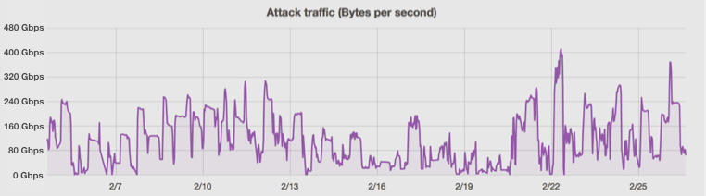
Traffic Volume Variation
Expensive option:
capacity ≥ peak traffic load
Gbps
DDoS attack on Feb. 2016
400
320
240
Significant Variation
160
80
0
2/19
2/22
2/25
Time
Source: https://blog.cloudflare.com/a-winter-of-400gbps-weekend-ddos-attacks/
Notes:
0> Another problem is that it’s hard to decide the capacity of firewall.
1> For example, this figure shows a significant traffic volume variation for ddos attack.
2> To fully protect our networks an expensive option is to let the capacity greater than the peak traffic load.

